Slide 1
Vector Spaces
LINEARLY INDEPENDENT SETS; BASES

Slide 2
LINEAR INDEPENDENT SETS
An indexed set of vectors {v₁, …, v_{p}} in V is said to be linearly independent if the vector equation
(1)
has only the trivial solution, .
The set {v₁, …, v_{p}} is said to be linearly dependent if (1) has a nontrivial solution, i.e., if there are some weights, c₁, …, c_{p}, not all zero, such that (1) holds.
In such a case, (1) is called a linear dependence relation among v₁, …, v_{p.}

Slide 3
LINEAR INDEPENDENT SETS
Theorem 4: An indexed set {v₁, …, v_{p}} of two or more vectors, with , is linearly dependent if and only if some v_{j} (with ) is a linear combination of the preceding vectors, .
Definition: Let H be a subspace of a vector space V. A set of vectors B in V is a basis for H if
(i) B is a linearly independent set, and
(ii) H = Span B

Slide 4
LINEAR INDEPENDENT SETS; BASES
A basis of V is a linearly independent set that spans V.
The definition of a basis applies to the case when , because any vector space is a subspace of itself.
When , condition (ii) includes the requirement that each of the vectors b₁, …, b_{p} must belong to H, because Span {b₁, …, b_{p}} contains b₁, …, b_{p}.

Slide 5
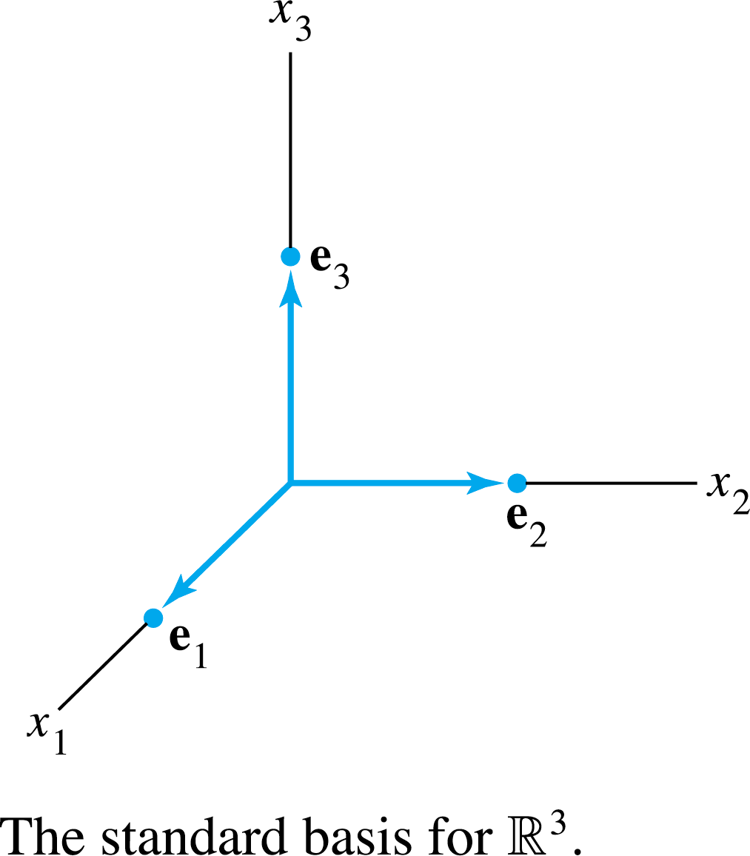

STANDARD BASIS
Let e₁, …, e_{n} be the columns of the matrix, I_{n}.
The set {e₁, …, e_{n}} is called the standard basis for .
$$ℝ^{n}$$

Slide 6
THE SPANNING SET THEOREM
Theorem 5: Let be a set in V, and let
If one of the vectors in S—say, v_{k}—is a linear combination of the remaining vectors in S, then the set formed from S by removing v_{k} still spans H.
If , some subset of S is a basis for H.

Slide 7
THE SPANNING SET THEOREM
Proof:
By rearranging the list of vectors in S, if necessary, we may suppose that v_{p} is a linear combination of
Given any x in H, write
for suitable scalars c₁, …, c_{p}.
Substituting the expression for v_{p} into the expression for x, it is easy to see that x is a linear combination of
Thus spans H, because x was an arbitrary element of H.

Slide 8
THE SPANNING SET THEOREM
If the original spanning set S is linearly independent, then it is already a basis for H.
Otherwise, one of the vectors in S depends on the others and can be deleted, by part (a).
So long as there are two or more vectors in the spanning set, we can repeat this process until the spanning set is linearly independent and hence is a basis for H.
If the spanning set is eventually reduced to one vector, that vector will be nonzero (and hence linearly independent) because .

Slide 9
THE SPANNING SET THEOREM
Example 1: Let , ,
and . Note that .
Show that , and then find a basis for the subspace H.
Solution: Every vector in Span {v₁, v₂} belongs to H because

Slide 10
THE SPANNING SET THEOREM
Now let x be any vector in H—say,
.
Since , we may substitute
Thus x is in Span {v₁, v₂}, so every vector in H already belongs to Span {v₁, v₂}.
We conclude that H and Span {v₁, v₂} are actually the same set of vectors.
It follows that {v₁, v₂} is a basis of H since {v₁, v₂} is linearly independent.

Slide 11
BASIS FOR COL B
Example 2: Find a basis for Col B, where
Solution: Each nonpivot column of B is a linear combination of the pivot columns.
In fact, and .
By the Spanning Set Theorem, we may discard b₂ and b₄, and {b₁, b₃, b₅} will still span Col B.

Slide 12
BASIS FOR COL B
Let
Since and no vector in S is a linear combination of the vectors that precede it, S is linearly independent.
Thus S is a basis for Col B.

Slide 13
BASES FOR COL A
Theorem 6: The pivot columns of a matrix A form a basis for Col A.
Proof: Let B be the reduced echelon form of A.
The set of pivot columns of B is linearly independent, for no vector in the set is a linear combination of the vectors that precede it.
Since A is row equivalent to B, the pivot columns of A are linearly independent as well, because any linear dependence relation among the columns of A corresponds to a linear dependence relation among the columns of B.

Slide 14
BASES FOR COL A
For this reason, every nonpivot column of A is a linear combination of the pivot columns of A.
Thus the nonpivot columns of A may be discarded from the spanning set for Col A, by the Spanning Set Theorem.
This leaves the pivot columns of A as a basis for Col A.
Warning: The pivot columns of a matrix A are evident when A has been reduced only to echelon form.
But, be careful to use the pivot columns of A itself for the basis of Col A.

Slide 15
THE ROW SPACE
Theorem 7: If two matrices A and B are row equivalent, then their row spaces are the same. If B is in echelon form, the nonzero rows of B form a basis for the row space of A as well as for that of B.
Proof: If B is obtained from A by row operations, the rows of B are linear combinations of the rows of A.
It follows that any linear combination of the rows of B is automatically a linear combination of the rows of A.

Slide 16
THE ROW SPACE
Thus the row space of B is contained in the row space of A.
Since row operations are reversible, the same argument shows that the row space of A is a subset of the row space of B.
So the two row spaces are the same.

Slide 17
THE ROW SPACE
If B is in echelon form, its nonzero rows are linearly independent because no nonzero row is a linear combination of the nonzero rows below it. (Apply Theorem 4 to the nonzero rows of B in reverse order, with the first row last).
Thus the nonzero rows of B form a basis of the (common) row space of B and A.

Slide 18
BASES FOR NUL A, COL A, AND ROW A
Example 3: Find bases for the row space, the column space, and the null space of the matrix
Solution: To find bases for the row space and the column space, row reduce A to an echelon form:

Slide 19
BASES FOR NUL A, COL A, AND ROW A
By Theorem 7, the first three rows of B form a basis for the row space of A (as well as for the row space of B).
Thus
Basis for Row

Slide 20
BASES FOR NUL A, COL A, AND ROW A
For the column space, observe from B that the pivots are in columns 1, 2, and 4.
Hence columns 1, 2, and 4 of A (not B) form a basis for Col A:
Basis for Col
Notice that any echelon form of A provides (in its nonzero rows) a basis for Row A and also identifies the pivot columns of A for Col A.

Slide 21
BASES FOR NUL A, COL A, AND ROW A
However, for Nul A, we need the reduced echelon form.
Further row operations on B yield

Slide 22
BASES FOR NUL A, COL A, AND ROW A
The equation is equivalent to , that is,
So , , , with x₃ and x₅ free variables.

Slide 23
BASES FOR NUL A, COL A, AND ROW A
The calculations show that
Basis for Nul
Observe that, unlike the basis for Col A, the bases for Row A and Nul A have no simple connection with the entries in A itself.

